Slide 1

Responsible Innovation
Welcome to Professional Practice 2

Slide 2
What Type of Bias Might You Have?
Confirmation Bias
Availability Bias
Framing Effect
Egocentric Bias
Logical Fallacy
False Priors
Prospect Theory

Slide 3
Activity 1:
Framing the design challenge

Slide 4
The problem we’re trying to solve is:
XYZ
When framed as a question, our problem is?
XYZ
The key outcome we’re trying to achieve is?
Things
Framing the design challenge.

Slide 5
Framing the design challenge.
The important aspects of the context or constraints that we need to consider are:
These could be shifts we need to see in the ecosystem around the user or factors that are technological or geographic or time based.

Slide 6
Some possible solutions to the design questions?
Think as broadly as possible – try the 5 whys
We’re rephrased our original design question. It now says:
Something….
Framing the design challenge.

Slide 7
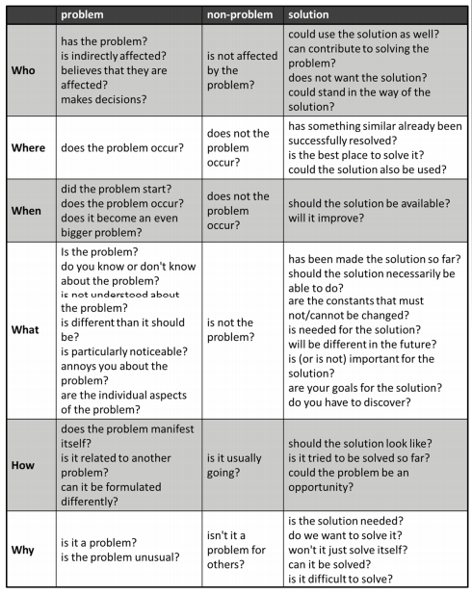
Problem Reframing
Reframing the Problem
(Müller-Roterberg, 2018, page 13)

Slide 8
Problem Framing
Solution Space
Maternal and child death is a problem in the developing world
Reduce pregnancy
High rates of pregnancy may result in maternal child death
Increase access to contraception
BUT! You can still suffer adverse maternal child complications if you are a consenting adult who WANTS the pregnancy
Many maternal/child deaths are caused by complications at birth
Reduce the complications at birth.
Let try reducing emergency caesarean sections (ECS) (high rate of injury and death)
What are all the different ways we can understand this situation
https://hbr.org/2017/01/are-you-solving-the-right-problems
ECS cause increased risk of death and harm to both mother and child
Increase access to hospitals and care providers able to undertake ECS
Reframe the problem
Reduce emergency caesarean sections
Reduce ECS by increasing knowledge and accessibility of bicarb soda (cheap, easy, accessible)
Minimal support for non-patentable research, funding by pharmaceutical companies etc for bicarb soda during birth process
Change the incentive structure for cheap, easy, accessible birth interventions and research
Empathy Map

Slide 9
Problem Framing
HoloLens doesn’t consider user privacy
Never use HoloLens
Solution Space
HoloLens might expose unwanted personal data
Require different user permission levels which can be granted according to scenarios or based on their relationship to other users
XYZ
XYZ
What are all the different ways we can understand this situation
https://hbr.org/2017/01/are-you-solving-the-right-problems
XYZ
XYZ
Reframe the problem
Empathy Map

Slide 10
Problem Framing
Your problem
Your Solution
Solution Space
Problem reframe
Alternative solution
XYZ
XYZ
What are all the different ways we can understand this situation
https://hbr.org/2017/01/are-you-solving-the-right-problems
XYZ
XYZ
Reframe the problem
Empathy Map

Slide 11
Activity 2:
Ecosystem Mapping

Slide 12
Refer to the handout from last week or PP1 handouts for Ecosystem Mapping

Slide 13
Activity 2:
Stakeholder Analysis Matrix

Slide 14
Government
Negative Support / moderate influence
Positive support / High Influence
End Users
High
Regulators
Technology Companies
Resources
Influence
Who are the stakeholders for this issue?
https://www.smartsheet.com/free-stakeholder-analysis-templates
Human Labour
Negative Support / Minimal Influence
Positive Support / Moderate or Low Influence
Stakeholder Analysis Matrix
Low
Low
High
Interest

Slide 15
Activity 4:
K W L Chart

Slide 16
K – W – L Charts
(Know, Want to Know, Learned)
What I know
X
What I want to know
Y
What I learned
Z

Slide 17
Activity 5:
Empathy Mapping

Slide 18
Says
Thinks
Saying
Thinking
User
What are our clients or users doing, thinking and feeling through out the experience?
Does
Feels
https://www.nngroup.com/articles/empathy-mapping/
Feeling
Doing
Empathy Map
Empathy Map

Slide 19
Activity 6:
As Is Scenario Mapping

Slide 20
As is Scenario Map
Phases
Phase
Doing
Doing
What are our clients or users doing, thinking and feeling through out the experience?
Thinking
Thinking
Feeling
Feeling
As is Scenario Map
https://www.ibm.com/design/thinking/page/toolkit/activity/as-is-scenario-map

Slide 21
Activity 7:
Assumptions and Questions Mapping

Slide 22
Assumptions
Questions
Assumptions and Questions.
What assumptions are you making about your project.
What questions do you have about your project?
Let everyone on your team add to the assumptions and questions
A1
Q1
Map out your assumptions, questions and rate them
Assumptions Questions and Actions Map

Slide 23
High Risk
Assumptions and Questions.
What assumptions are you making about your project.
What questions do you have about your project?
Let everyone on your team add to the assumptions and questions
A1
Certain
Uncertain
Map out your assumptions, questions and rate them
Assumptions Questions and Actions Map
Q1
Low Risk

Slide 24
Assumptions and Questions
Means to Resolve your Assumptions and Questions
What options do you have to resolve your questions and assumptions?
This should help you build an action plan to resolve them.
A1
Surveys
Card Sort Activity
Map out your assumptions, questions and rate them
User Interviews
Assumptions Questions and Actions Map

